Slide 1
Capstone Project - The Battle of Neighborhoods (Week 2)
Mukesh Kolladikkal

Slide 2


Restaurant Location Recommendation Using Neighborhood Clustering – New Delhi

Slide 3

Introduction: Business Problem
In ths project will try to find an optimal location for a restaurant. Specifically, this report will be targeted to stakeholders interested in opening an Indian Cuisine restaurant in Delhi, India. Finding a suitable location for restaurants in major cities like Delhi proves to be a daunting task. Various factors such as over-saturation or no demand ,for the type of restaurant that the customer wants to open, effect the success or failure of the restaurant. Hence, customers can bolster their decisions using the descriptive and predictive capabilities of data science

Slide 4

Data Acquisition and preparation
.number of existing restaurants in the neighborhood (any type of restaurant) .number of and distance to Indian restaurants in the neighborhood, if any .distance of neighborhood from popular neighborhoods
In our project we will:
acquire the names and boroughs of the neighborhoods by scrapping a wikipedia page. After we have got the names of all the neighborhoods, we will geocode them using the library geopy.geocoder (Nominatim). Next, we use the foursquare API to find all types of restaurants within a 1000 meter radius for every neighborhood.

Slide 5
Foursquare
'The Foursquare Places API provides location based experiences with diverse information about venues, users, photos, and check-ins. The API supports real time access to places, Snap-to-Place that assigns users to specific locations, and Geo-tag.'

Slide 6
Data
To solve the problem, we will need the following data:
• Delhi data containing the neighborhoods and boroughs.
• Latitude and longitude coordinates of those neighborhoods. This is required to plot the map and get the venue data.
• Venue data, particularly data related to restaurants. We are going to use this data to perform further analysis of the neighborhoods.
Data Source and methods to extract them Delhi data containing the neighborhoods and boroughs will be obtained from the open data source:

Slide 7
Data
https://en.wikipedia.org/wiki/Neighbourhoods_of_Delhi. After it, we will get the geographical coordinates of the neighborhoods (latitude and longitude) using Python Geocoder package. Finally, we will use Foursquare API to get the venue data for the neighborhoods defined at the previous step. Foursquare has one of the largest databases of 105+ million places and over 125,000 developers use this application. Foursquare API provides many categories of the venue data; we are particularly interested in the restaurant data to solve the business problem defined above. This project will require using of many data science skills, from web scrapping (open source dataset), working with API (Foursquare), data cleaning, data wrangling, to map visualization (Folium). In the next Methodology section, we will discuss and describe any exploratory data analysis that we did, any inferential statistical testing that we performed, and what machine learning techniques were used.

Slide 8
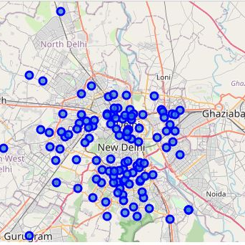
Methodology and Analysis
First we used Folium library to plot the geographical coordinates onto map for better visualization from the data.

Slide 9
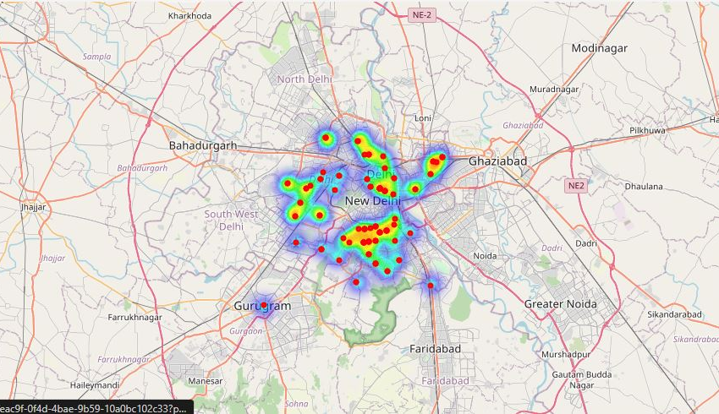
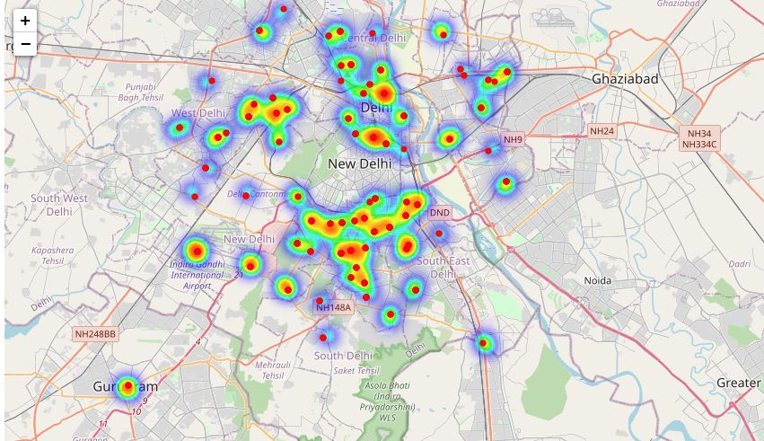
Heat map for analyzing the density of restaurants

Slide 10
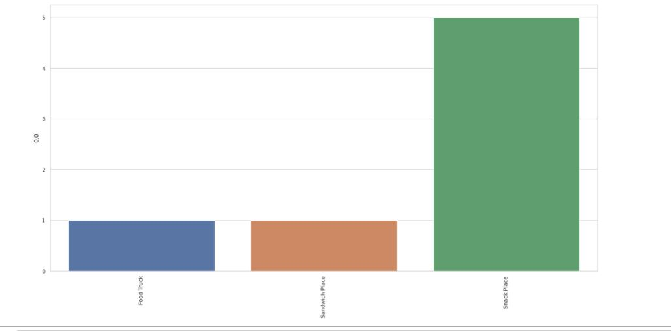
Cluster Comparison

Slide 11
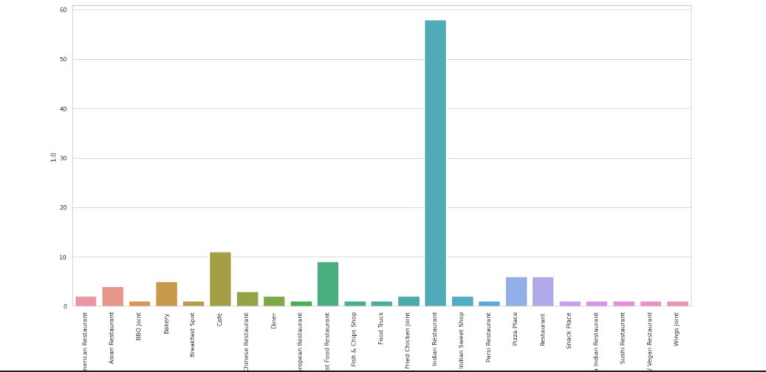
Cluster Comparison

Slide 12
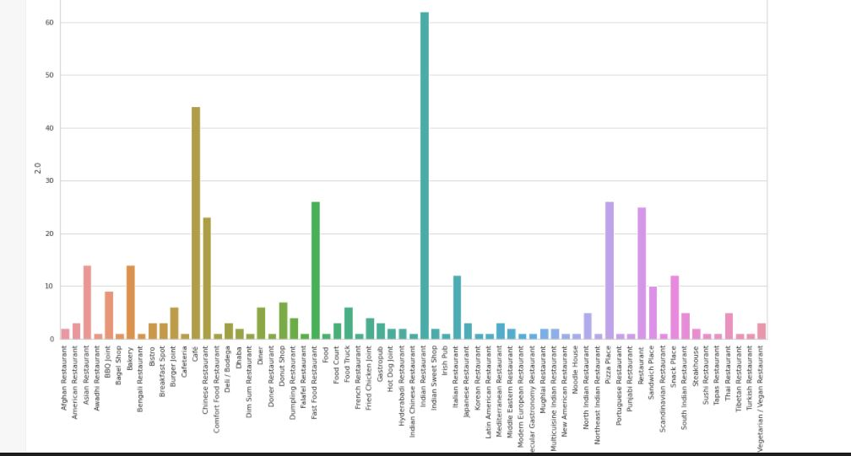
Cluster Comparison

Slide 13

Results and Discussions
Our Analysis was done on over 129 neighborhoods, containing over 848 restaurants within 2km radius of every neighborhood. We segragated these neighborhoods on the basis of types and amounts of restaurants. Five clusters were obtained, each having a unique collection of restaurants. Since, we were focused on finding optimal neighborhoods for opening Indian restaurants, we selected cluster 2 and 3 which had the highest number of Indian restaurants. The above actions left us with the only those neighborhoods that had a shared characteristics of and that had a high demand for Indian restaurants.
*The neighborhoods recommendation obtained here are not completely accurate. This is due to the limitations in the dataset used in the project. Due to lack of cross referencing sources, we may have missed a few neighborhoods from our consideration.

Slide 14




Thank you

